Slide 1
ECE 753 project
Pumped storage hydro turbine bidding strategies
in day-ahead market
Dwaraknaath Varadharajan
MS in EE
NC State University

Slide 2
Observations and inference
Price peaks do not occur at load peaks in all cases.
The profits for a pumped storage owner is maximized if the owner buys power at least cost and sells stored power at a higher price.
The owner can also bid into the reserve market when it is not generating. This increases the profit as well.
The pumped storage can also be bid into the spinning reserve during pumping because it can readily reduce its power consumption.

Slide 3

Operational constraints
Tpmax$=\frac{T}{1+η×\frac{Pp}{Pg}}$ - Maximum pumping time within a period T
E_{t}=E₀+E_{in}-E_{out}
At any time,
E_{t} > Emin && E_{t} < Emax

Slide 4
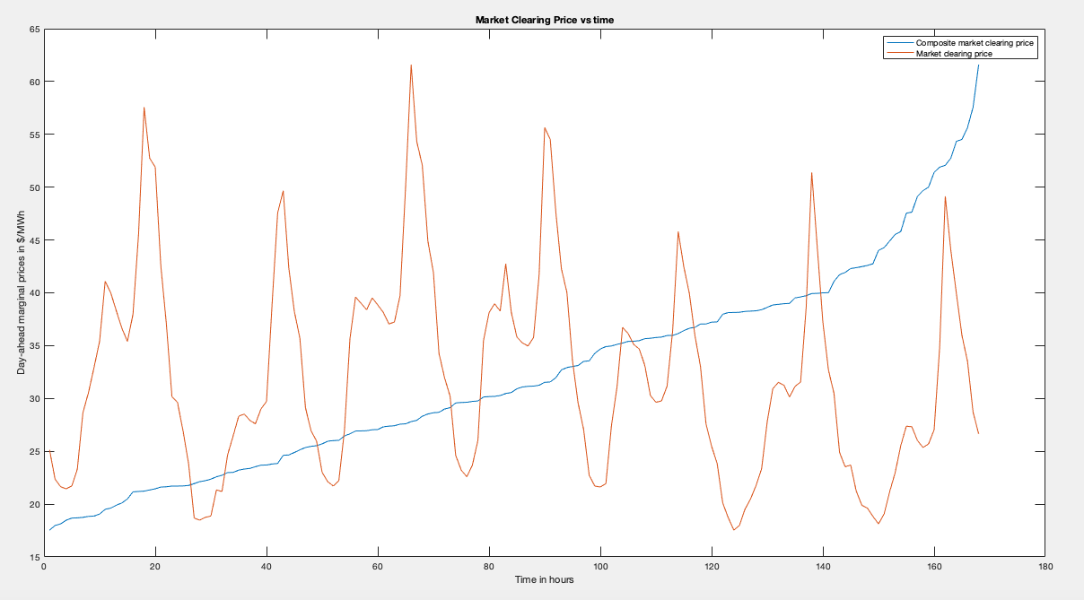
LMP and MCP – week 1

Slide 5
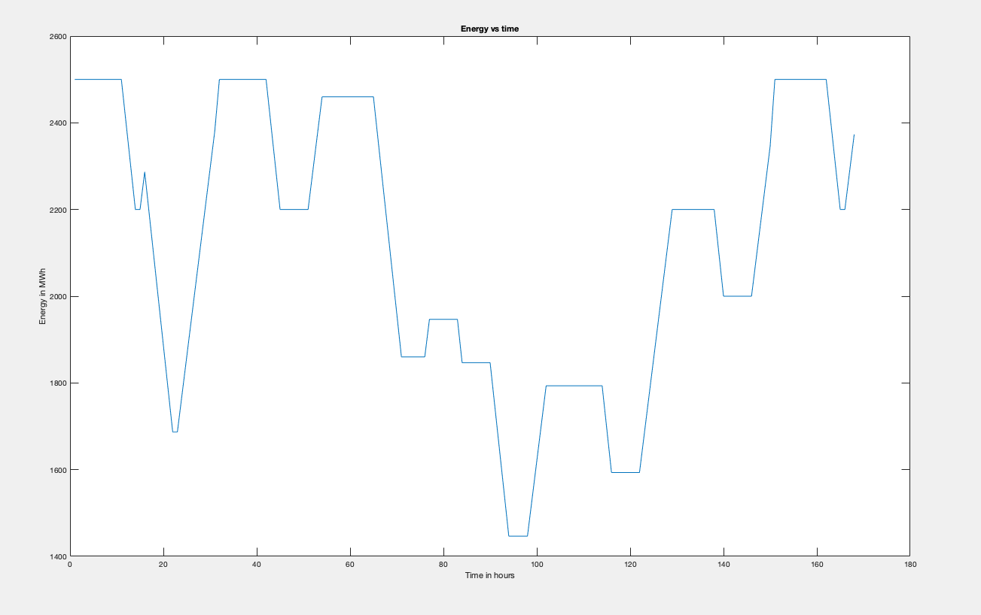
Energy stored – week 1

Slide 6
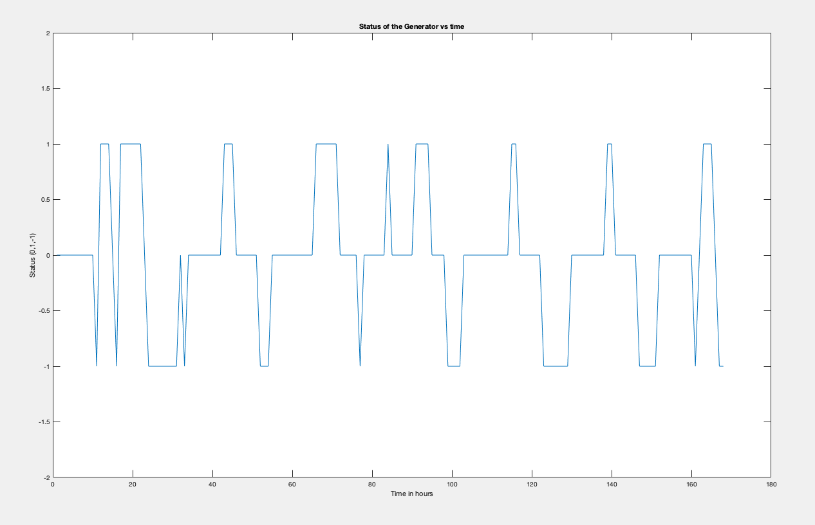
Status of pumped storage – week 1

Slide 7
Results – week 1
hour | Monday | Tuesday | Wednesday | Thursday | Friday | Saturday | Sunday
1 | 0 | -1 | 0 | 0 | 0 | 0 | 0
2 | 0 | -1 | 0 | 0 | 0 | 0 | 0
3 | 0 | -1 | 0 | 0 | -1 | -1 | -1
4 | 0 | -1 | -1 | 0 | -1 | -1 | -1
5 | 0 | -1 | -1 | -1 | -1 | -1 | -1
6 | 0 | -1 | -1 | 0 | -1 | -1 | -1
7 | 0 | -1 | 0 | 0 | 0 | -1 | -1
8 | 0 | 0 | 0 | 0 | 0 | -1 | 0
9 | 0 | -1 | 0 | 0 | 0 | -1 | 0
10 | 0 | 0 | 0 | 0 | 0 | 0 | 0
11 | -1 | 0 | 0 | 0 | 0 | 0 | 0
12 | 1 | 0 | 0 | 1 | 0 | 0 | 0
13 | 1 | 0 | 0 | 0 | 0 | 0 | 0
14 | 1 | 0 | 0 | 0 | 0 | 0 | 0
15 | 0 | 0 | 0 | 0 | 0 | 0 | 0
16 | -1 | 0 | 0 | 0 | 0 | 0 | 0
17 | 1 | 0 | 0 | 0 | 0 | 0 | -1
18 | 1 | 0 | 1 | 0 | 0 | 0 | 0
19 | 1 | 1 | 1 | 1 | 1 | 1 | 1
20 | 1 | 1 | 1 | 1 | 1 | 1 | 1
21 | 1 | 1 | 1 | 1 | 0 | 0 | 1
22 | 1 | 0 | 1 | 1 | 0 | 0 | 0
23 | 0 | 0 | 1 | 0 | 0 | 0 | -1
24 | -1 | 0 | 0 | 0 | 0 | 0 | -1
-1 denotes pumping
+1 denotes generating

Slide 8
Results – week 1
Iterations | Start_time | End_time | Bp | Bg | tp | tg | Profit
1 | 10 | 31 | 35.4 | 37.1 | 11 | 9.533333333 | 17602.2333
2 | 32 | 150 | 22.7 | 41.7 | 21 | 18.2 | 53652.3
3 | 150 | 151 | 18.1 | 19.1 | 1 | 0.866666667 | 1857.63333
Total |  |  |  |  |  |  | 74343

Slide 9
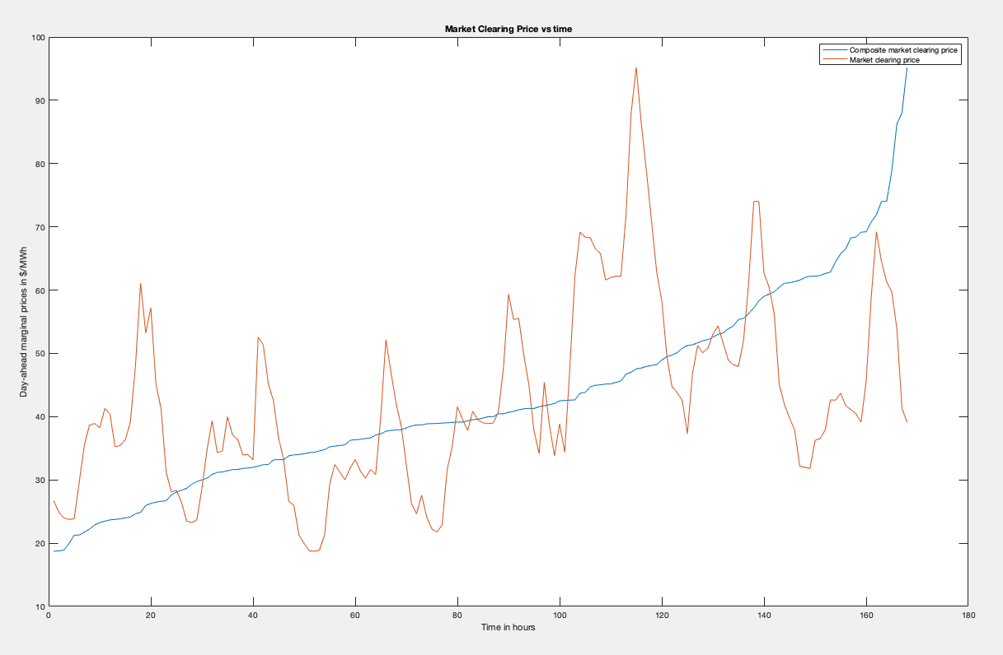
LMP and MCP – week 2

Slide 10
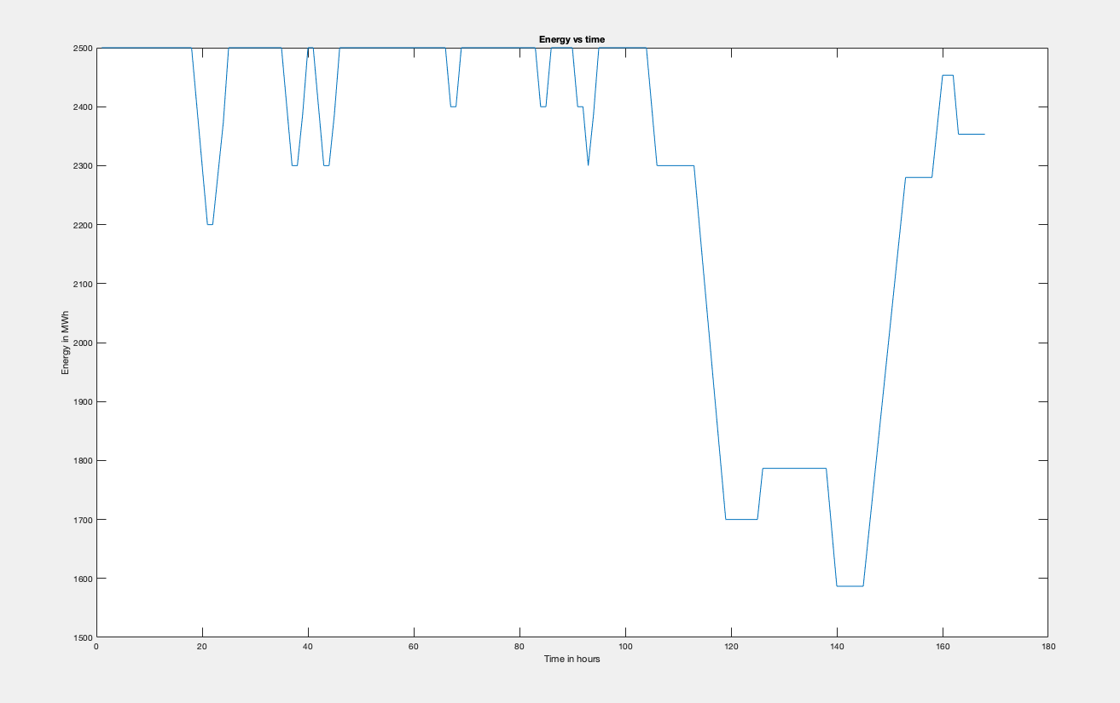
Energy stored – week 2

Slide 11
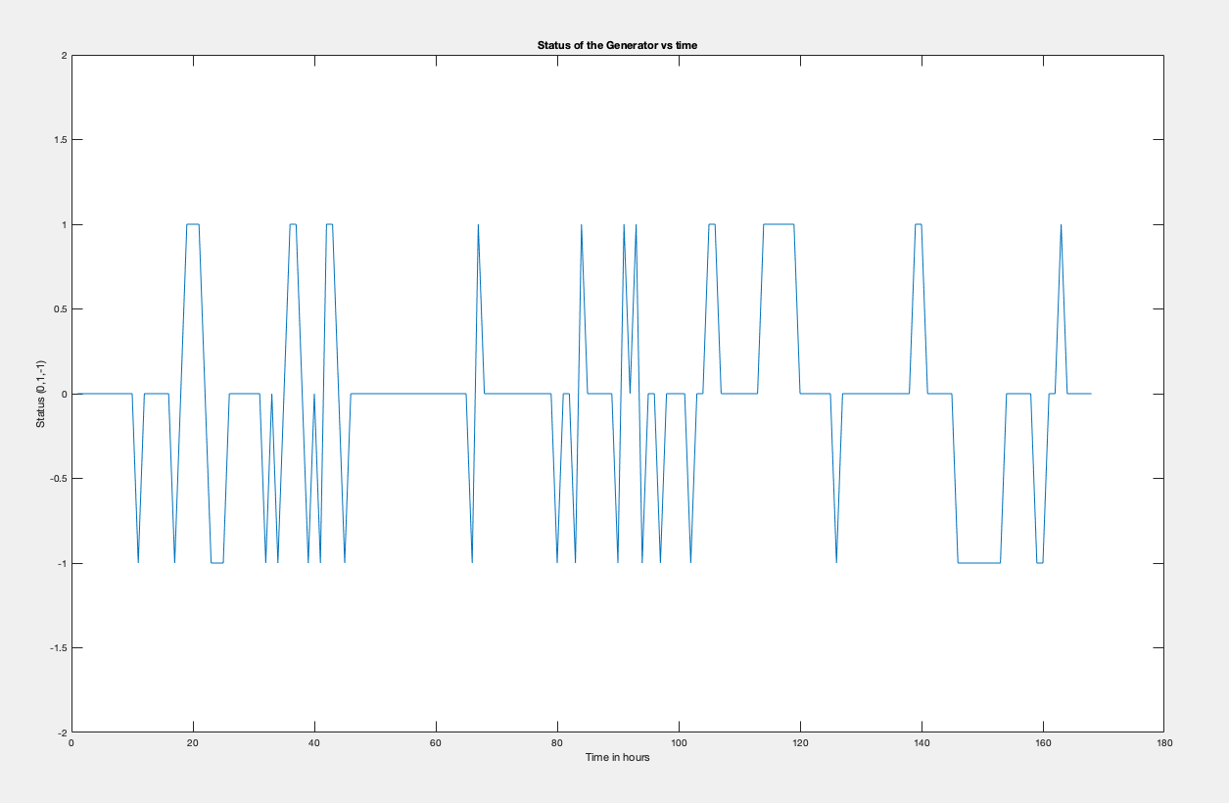
Status of pumped storage – week 2

Slide 12
Results – week 2
hour | Monday | Tuesday | Wednesday | Thursday | Friday | Saturday | Sunday
1 | 0 | -1 | 0 | 0 | -1 | 0 | 0
2 | 0 | 0 | 0 | 0 | 0 | 0 | -1
3 | 0 | 0 | 0 | 0 | 0 | 0 | -1
4 | 0 | 0 | 0 | 0 | 0 | 0 | -1
5 | 0 | 0 | 0 | 0 | 0 | 0 | -1
6 | 0 | 0 | 0 | 0 | -1 | -1 | -1
7 | 0 | 0 | 0 | 0 | 0 | 0 | -1
8 | 0 | -1 | 0 | -1 | 0 | 0 | -1
9 | 0 | 0 | 0 | 0 | 1 | 0 | -1
10 | 0 | -1 | 0 | 0 | 1 | 0 | 0
11 | -1 | 0 | 0 | -1 | 0 | 0 | 0
12 | 0 | 1 | 0 | 1 | 0 | 0 | 0
13 | 0 | 1 | 0 | 0 | 0 | 0 | 0
14 | 0 | 0 | 0 | 0 | 0 | 0 | 0
15 | 0 | -1 | 0 | 0 | 0 | 0 | -1
16 | 0 | 0 | 0 | 0 | 0 | 0 | -1
17 | -1 | -1 | 0 | 0 | 0 | 0 | 0
18 | 0 | 1 | -1 | -1 | 1 | 0 | 0
19 | 1 | 1 | 1 | 1 | 1 | 1 | 1
20 | 1 | 0 | 0 | 0 | 1 | 1 | 0
21 | 1 | -1 | 0 | 1 | 1 | 0 | 0
22 | 0 | 0 | 0 | -1 | 1 | 0 | 0
23 | -1 | 0 | 0 | 0 | 1 | 0 | 0
24 | -1 | 0 | 0 | 0 | 0 | 0 | 0
-1 denotes pumping
+1 denotes generating

Slide 13
Results – week 2
Iterations | Start_time | End_time | Bp | Bg | tp | tg | Profit
1 | 10 | 12 | 38.2 | 41.3 | 1 | 0.866666667 | 3447.4
2 | 16 | 24 | 41.2 | 48.1 | 4 | 3.466666667 | 8718.73333
3 | 24 | 25 | 28.1 | 28.4 | 1 | 0.866666667 | 2298.83333
4 | 31 | 32 | 34.8 | 39.3 | 1 | 0.866666667 | 3477.43333
5 | 33 | 39 | 34.3 | 36.4 | 3 | 2.6 | 2255.6
6 | 40 | 45 | 42.5 | 45.2 | 3 | 2.6 | 4987
7 | 65 | 68 | 42.1 | 47 | 2 | 1.733333333 | 4009.63333
8 | 79 | 81 | 35.3 | 41.6 | 1 | 0.866666667 | 3872.2
9 | 82 | 85 | 39 | 39.5 | 2 | 1.733333333 | 2258.26667
10 | 89 | 94 | 49.7 | 55.4 | 3 | 2.6 | 3826.7
11 | 96 | 97 | 34.1 | 45.4 | 1 | 0.866666667 | 4696.86667
12 | 101 | 168 | 40.5 | 68.3 | 13 | 11.26666667 | 42134.7
Total |  |  |  |  |  |  | 85983.3667

Slide 14
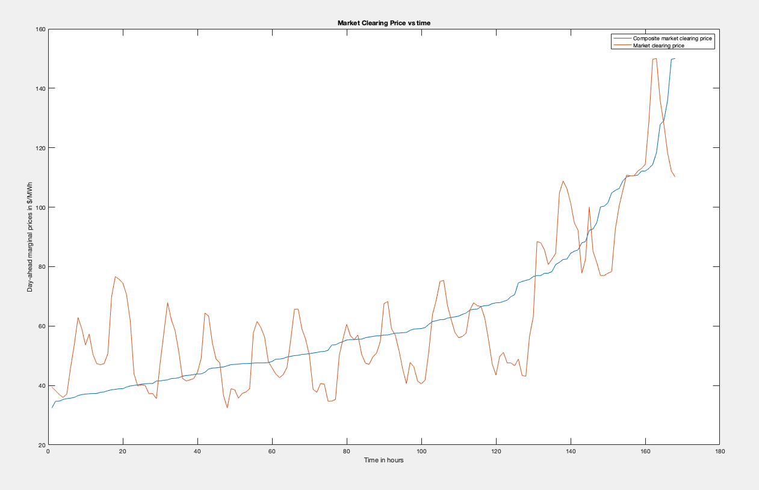
LMP and MCP – week 3

Slide 15
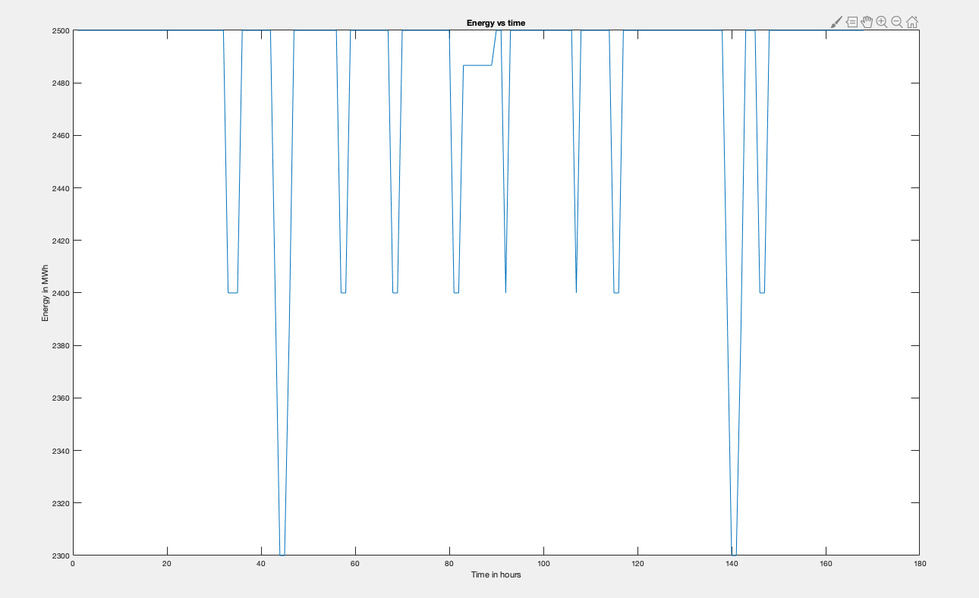
Energy stored – week 3

Slide 16
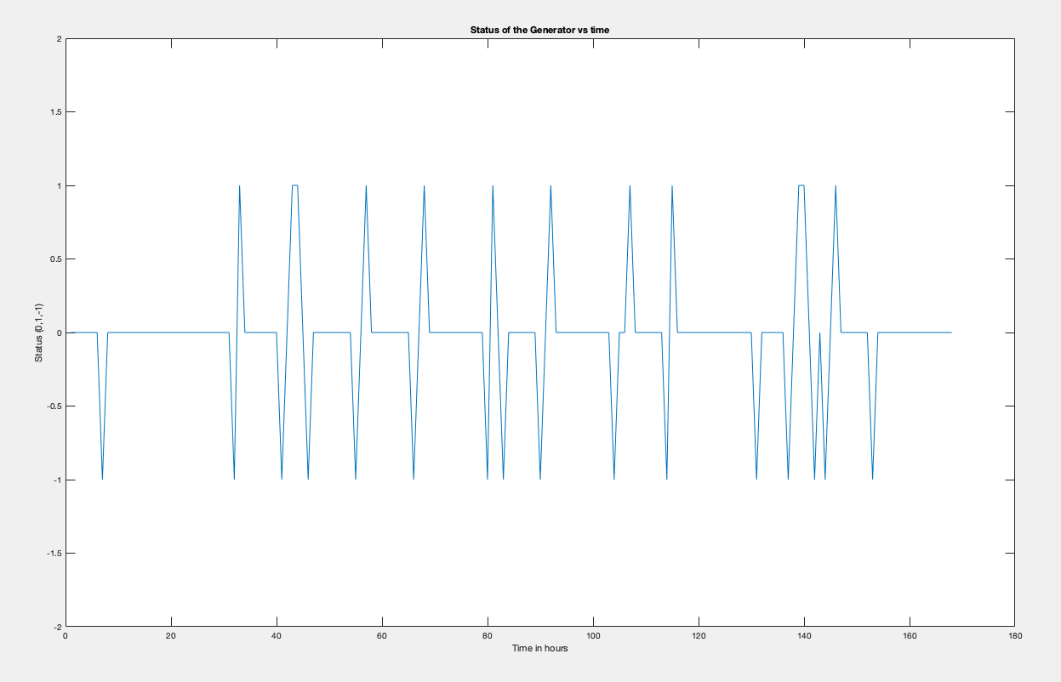
Status of pumped storage – week 3

Slide 17
Results – week 3
hour | Monday | Tuesday | Wednesday | Thursday | Friday | Saturday | Sunday
1 | 0 | 0 | 0 | 0 | 0 | 0 | 0
2 | 0 | 0 | 0 | 0 | 0 | 0 | 1
3 | 0 | 0 | 0 | 0 | 0 | 0 | 0
4 | 0 | 0 | 0 | 0 | 0 | 0 | 0
5 | 0 | 0 | 0 | 0 | 0 | 0 | 0
6 | 0 | 0 | 0 | 0 | 0 | 0 | 0
7 | -1 | 0 | -1 | 0 | 0 | 0 | 0
8 | 0 | -1 | 0 | -1 | -1 | 0 | 0
9 | 0 | 1 | 1 | 1 | 0 | 0 | -1
10 | 0 | 0 | 0 | 0 | 0 | 0 | 0
11 | 0 | 0 | 0 | -1 | 1 | -1 | 0
12 | 0 | 0 | 0 | 0 | 0 | 0 | 0
13 | 0 | 0 | 0 | 0 | 0 | 0 | 0
14 | 0 | 0 | 0 | 0 | 0 | 0 | 0
15 | 0 | 0 | 0 | 0 | 0 | 0 | 0
16 | 0 | 0 | 0 | 0 | 0 | 0 | 0
17 | 0 | -1 | 0 | 0 | 0 | -1 | 0
18 | 0 | 0 | -1 | -1 | -1 | 0 | 0
19 | 0 | 1 | 0 | 0 | 1 | 1 | 0
20 | 0 | 1 | 1 | 1 | 0 | 1 | 0
21 | 0 | 0 | 0 | 0 | 0 | 0 | 0
22 | 0 | -1 | 0 | 0 | 0 | -1 | 0
23 | 0 | 0 | 0 | 0 | 0 | 0 | 0
24 | 0 | 0 | 0 | 0 | 0 | -1 | 0
-1 denotes pumping
+1 denotes generating

Slide 18
Results – week 3
Iterations | Start_time | End_time | Bp | Bg | tp | tg | Profit
1 | 6 | 22 | 45.9 | 76.65 | 1 | 0.866666667 | 9752.86667
2 | 31 | 35 | 57.6 | 62.15 | 2 | 1.733333333 | 4740
3 | 40 | 46 | 48.9 | 54.33 | 3 | 2.6 | 5170.1
4 | 54 | 58 | 56.3 | 59.5 | 2 | 1.733333333 | 5449.76667
5 | 65 | 69 | 55.6 | 65.65 | 2 | 1.733333333 | 4901.86667
6 | 79 | 83 | 55.6 | 56.97 | 2 | 1.733333333 | 2859.93333
7 | 89 | 92 | 59.1 | 67.53 | 2 | 1.733333333 | 5046.33333
8 | 103 | 107 | 67 | 75 | 2 | 1.733333333 | 4885.23333
9 | 113 | 116 | 66.6 | 66.86 | 2 | 1.733333333 | 2535.1
10 | 130 | 131 | 63.1 | 88.43 | 1 | 0.866666667 | 8961.9
11 | 136 | 142 | 94.7 | 104.8 | 3 | 2.6 | 5018.6
12 | 143 | 147 | 81.4 | 85.19 | 2 | 1.733333333 | 5442.9
13 | 152 | 168 | 92.7 | 150 | 1 | 0.866666667 | 17360.8667
Total |  |  |  |  |  |  | 82125.4667

Slide 19
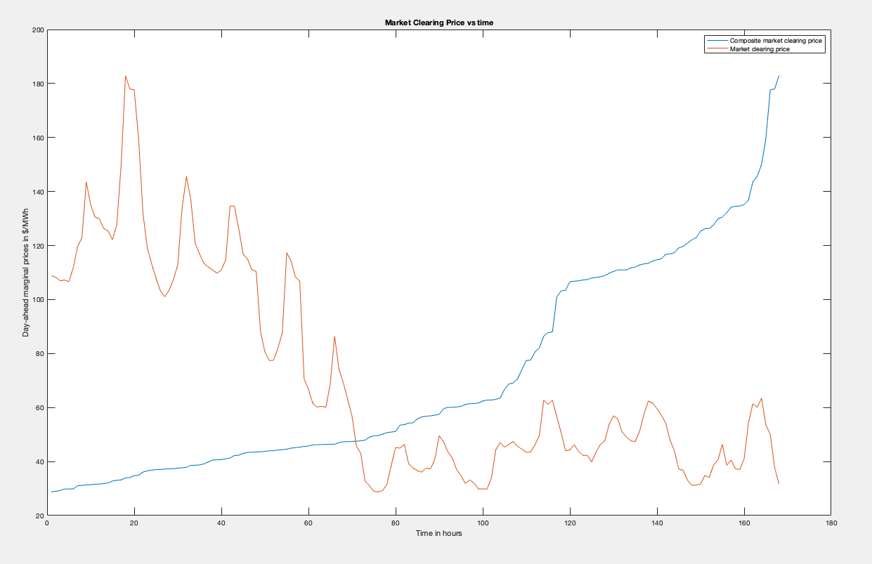
LMP and MCP – week 4

Slide 20
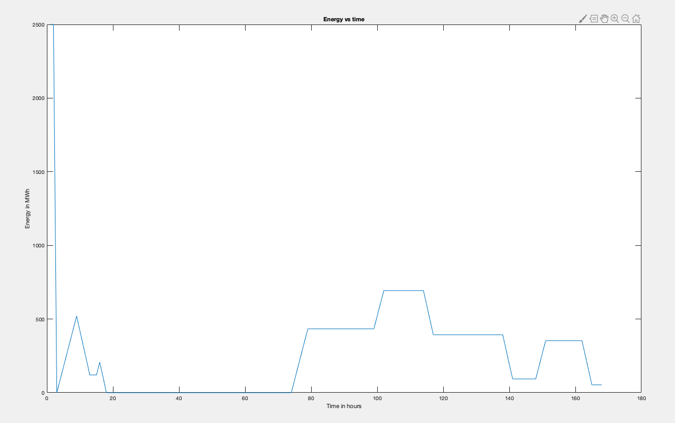
Energy stored – week 4

Slide 21
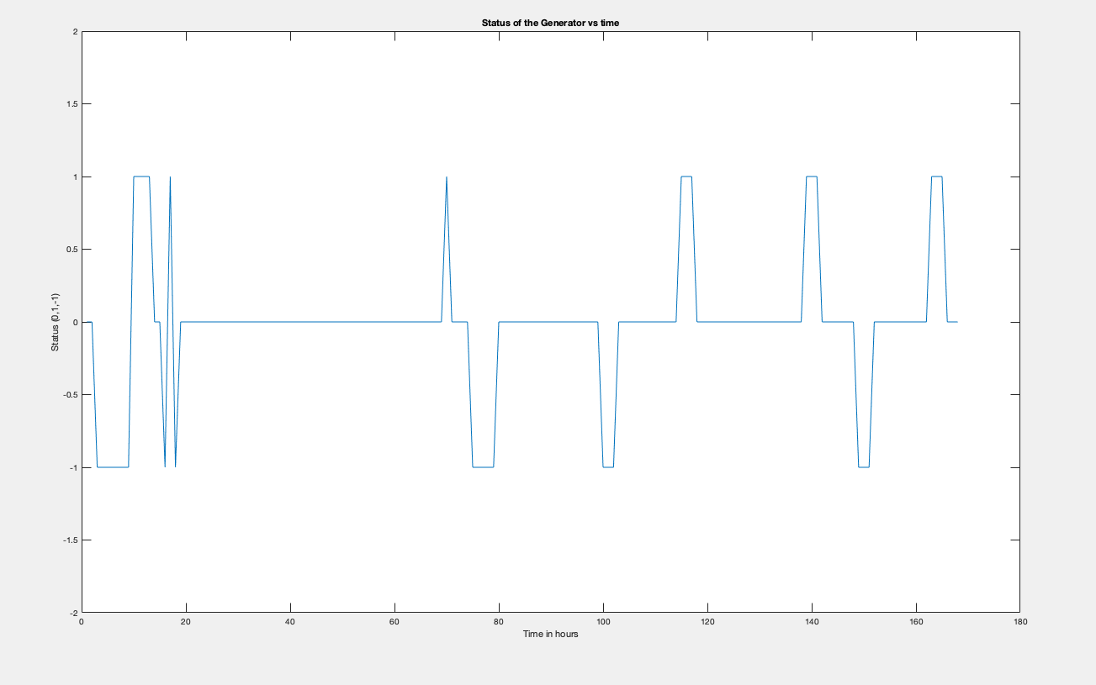
Status of pumped storage – week 4

Slide 22
Results – week 4
hour | Monday | Tuesday | Wednesday | Thursday | Friday | Saturday | Sunday
1 | 0 | 0 | 0 | -1 | -1 | -1 | 0
2 | 1 | 0 | 0 | -1 | -1 | 1 | 0
3 | 1 | 0 | 0 | -1 | -1 | -1 | 0
4 | -1 | 0 | 0 | -1 | -1 | -1 | 0
5 | 1 | 0 | 0 | -1 | -1 | -1 | -1
6 | -1 | 0 | 0 | -1 | -1 | -1 | -1
7 | -1 | 0 | 0 | -1 | -1 | -1 | -1
8 | -1 | 0 | 0 | -1 | -1 | 1 | 0
9 | 1 | 0 | 0 | 1 | 1 | 1 | 0
10 | 1 | 0 | 0 | 1 | 1 | 1 | 0
11 | 0 | 0 | 0 | 1 | 1 | 1 | 0
12 | 0 | 0 | 0 | -1 | 1 | 1 | 1
13 | 0 | 0 | 0 | -1 | 1 | 1 | 0
14 | 0 | 0 | 0 | -1 | 1 | 1 | 0
15 | 0 | 0 | 0 | -1 | -1 | 1 | 0
16 | 0 | 0 | 0 | -1 | -1 | 1 | 0
17 | 0 | 0 | 0 | -1 | 1 | 1 | 0
18 | 0 | 0 | 0 | -1 | 1 | 1 | 1
19 | 0 | 0 | 0 | 1 | 1 | 1 | 1
20 | 0 | 0 | 0 | 1 | 1 | 1 | 0
21 | 0 | 0 | 0 | -1 | 1 | 0 | 0
22 | 0 | 0 | 0 | -1 | 1 | 0 | 0
23 | 0 | 0 | 0 | -1 | 1 | 0 | 0
24 | 0 | 0 | 0 | -1 | -1 | 0 | 0
-1 denotes pumping
+1 denotes generating

Slide 23
Results – week 4
Iterations | Start_time | End_time | Bp | Bg | tp | tg | Profit
1 | 2 | 17 | 122.9 | 126.3 | 8 | 6.933333333 | -6342.4
2 | 17 | 18 | 150 | 182.9 | 1 | 0.866666667 | 15295
3 | 61 | 62 | 60.19 | 61.48 | 1 | 0.866666667 | 4308.23333
4 | 63 | 64 | 60.06 | 60.46 | 1 | 0.866666667 | 4134.73333
5 | 69 | 168 | 31.64 | 57.47 | 12 | 10.4 | 34140
 |  |  |  |  |  | Total | 51535.5667

Slide 24
Results – Jan 2019
Date | Week | Profit
31 Dec 2018 - 6 Jan 2019 | 1 | $ 74,343
7 Jan 2019 – 13 Jan 2019 | 2 | $ 85,983.3667
14 Jan 2019 – 20 Jan 2019 | 3 | $ 82,125.4667
21 Jan 2019 – 27 Jan 2019 | 4 | $ 51,535.5667
Total |  | $ 293,987.334

